Slide 1
A randomized, double-blind, placebo-controlled study to assess efficacy of mirtazapine for the treatment of diarrhea predominant irritable bowel syndrome
Alireza Khalilian¹, Maryam Mehrpooya^{2*} Davoud Ahmadimoghaddam^{2*}, Shiva Saki², Younes Mohammadi⁴
1Department of Internal Medicine, School of Medicine, Hamadan University of Medical Sciences, Hamadan, Iran.
2Department of Clinical Pharmacy, School of Pharmacy, Hamadan University of Medical Sciences, Hamadan, Iran.
3Department of Pharmacology&Toxicology, School of Pharmacy, Hamadan University of Medical Sciences, Hamadan, Iran.
4Modeling of Noncommunicable Diseases Research Center, School of Public Health, Hamadan University of Medical Sciences, Hamadan, Iran.
*Corresponding Author: Maryam Mehrpooya

Slide 2
BACKGROUND
A large body of evidence indicates that abnormalities of serotonergic function have a central role in both intestinal and extraintestinal symptoms of Irritable bowel syndrome (IBS) (1,2). It has been found Serotonin (5-HT) dysfunction in the gut by affecting intestinal motor and secretory function may lead to either constipation or diarrhea. Additionally, altered 5-HT signaling in the central nervous system and the gut contributes to hypersensitivity in IBS (3). It is known that 5-HT3 receptor antagonists, such as alosetron can improve symptoms of stool frequency, urgency, abdominal discomfort, and stool consistency in patients with IBS with diarrhea (IBS-D). However, although rare, there are still clear concerns regarding the occurrence of serious adverse effects such as ischemic colitis with these agents (4).

Slide 3
BACKGROUND
Mirtazapine is an atypical antidepressant drug that promotes the release of noradrenaline serotonin by blocking α2-adrenergic autoandreceptors and α2-adrenergic heteroreceptors, respectively. It also enhances serotonin neurotransmission, mainly through 5-HT1A receptors by blocking postsynaptic 5-HT2A, 5-HT2C, and 5-HT3 receptors (5). Considering the 5-HT3 receptor antagonist property of mirtazapine, we designed this double-blind, placebo-controlled study to evaluate whether compared to placebo, mirtazapine would be efficacious and safe in the treatment of patients suffering from IBS-D.

Slide 4
Material & Methods
This double blind, randomized, placebo-controlled study was conducted from November 2019 until July 2020 in a gastroenterology clinic affiliated to Hamadan University of Medical Sciences, Hamadan, Iran.
The trial comprised a one-week run-in period and an 8-week intervention phase. 67 patients meeting Rome IV criteria for IBS-D were randomized in a double-blind fashion into either the mirtazapine treatment group (n=34) or the placebo treatment group (n=33).
Patients started with mirtazapine 15 mg/day at bedtime for one-week; after which the dose was increased to 30 mg/day for an additional 7-week. Placebo was administered in an identical manner. Use of loperamide (up 2 mg three times daily) as a rescue medication was permitted for treatment of acute uncontrolled diarrhea, but the patients were required to not use any loperamide rescue medication during the 1-week run-in period, and during the last week of the treatment period.

Slide 5
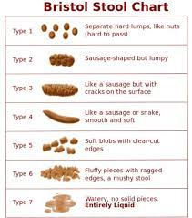
Material & Methods
All subjects were required to complete daily stool diary for a 7-day period, once during the 1-week run-in period and once during the last week of the treatment. Daily stool diary provides information on stool consistency (based on the Bristol Stool Form Scale (BSFS) from 1 (very hard) to 7 (watery)), frequency of defecation, and the severity of abdominal pain, urgency of defecation, and bloating (6). A number of days with pain, urgency, diarrhea, and bloating were also recorded.
The IBS Severity Scoring System questionnaire (IBS-SSS) was also used for assessing the severity of IBS symptoms. IBS-SSS is a patient based scale that assesses 5 clinically relevant items during a 7-day period: (1) severity of abdominal pain, (2) frequency of abdominal pain, (3) severity of abdominal distention or tightness, (4) dissatisfaction with bowel habits, and (5) interference of IBS with life in general. Each item is scored on a visual analog scale (VAS) from 0–100, yielding overall scores ranging from 0 to 500 (a higher score indicates worse condition) (7).
Further, once at the end of 1-week run-in period and once after 8 weeks of treatment (end of the study period), the subjects were requested to the Hospital Anxiety and Depression Scale questionnaire (HADS) for assessing psychological comorbidities (8) and 2) the IBS Quality of Life (IBS-QoL) questionnaire for assessing the degree to which IBS interferes with patient quality of life (9).

Slide 6
Results
54 patients (80.6%) completed the entire course of the study. All analyses were performed on an ITT analysis data set. The gender distribution was in favor of females in both groups. The mean age of the patients in the mirtazapine and placebo groups was 44.41 and 43.45 years, respectively. The mean duration of IBS was 10.0 years in the mirtazapine group and 9.2 years in the placebo group.
Table 1 shows the change in the clinical outcomes including IBS-SSS, IBS-QoL, and HADS scores from baseline to week 8 by treatment allocation. According to the obtain results, the change in IBS-SSS overall score during the trial course was significantly greater in the mirtazapine-treated subjects than the placebo-treated subjects (89.76 vs. 34.73; P-value = 0.002). With respect to responder rate which was defined as a 50-point or more reduction in IBS-SSS overall score at the end of treatment, 61.8% in the mirtazapine-treated group compared to 30.3% in the placebo-treated group were responders (P-value=0.01; Figure 1).
We also noted more improvement in the patients’ anxiety symptoms in the mirtazapine-treated subjects compared to the placebo-treated subjects. A noticeable improvement in the IBS-QoL score was also seen in the intervention group compared to the control group.

Slide 7
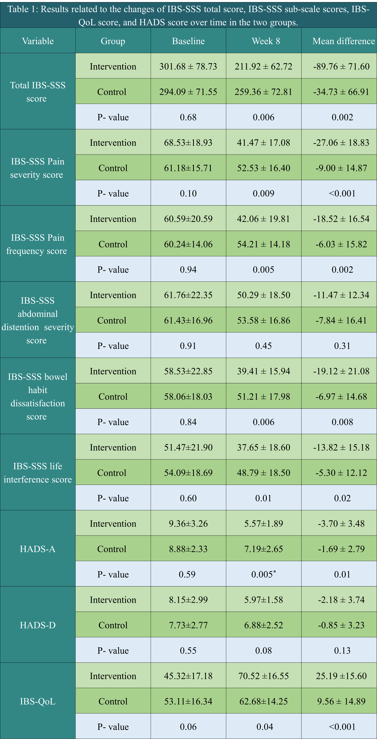
Table1
Table 1: Results related to the changes of IBS-SSS total score, IBS-SSS sub-scale scores, IBS-QoL score, and HADS score over time in the two groups.

Slide 8
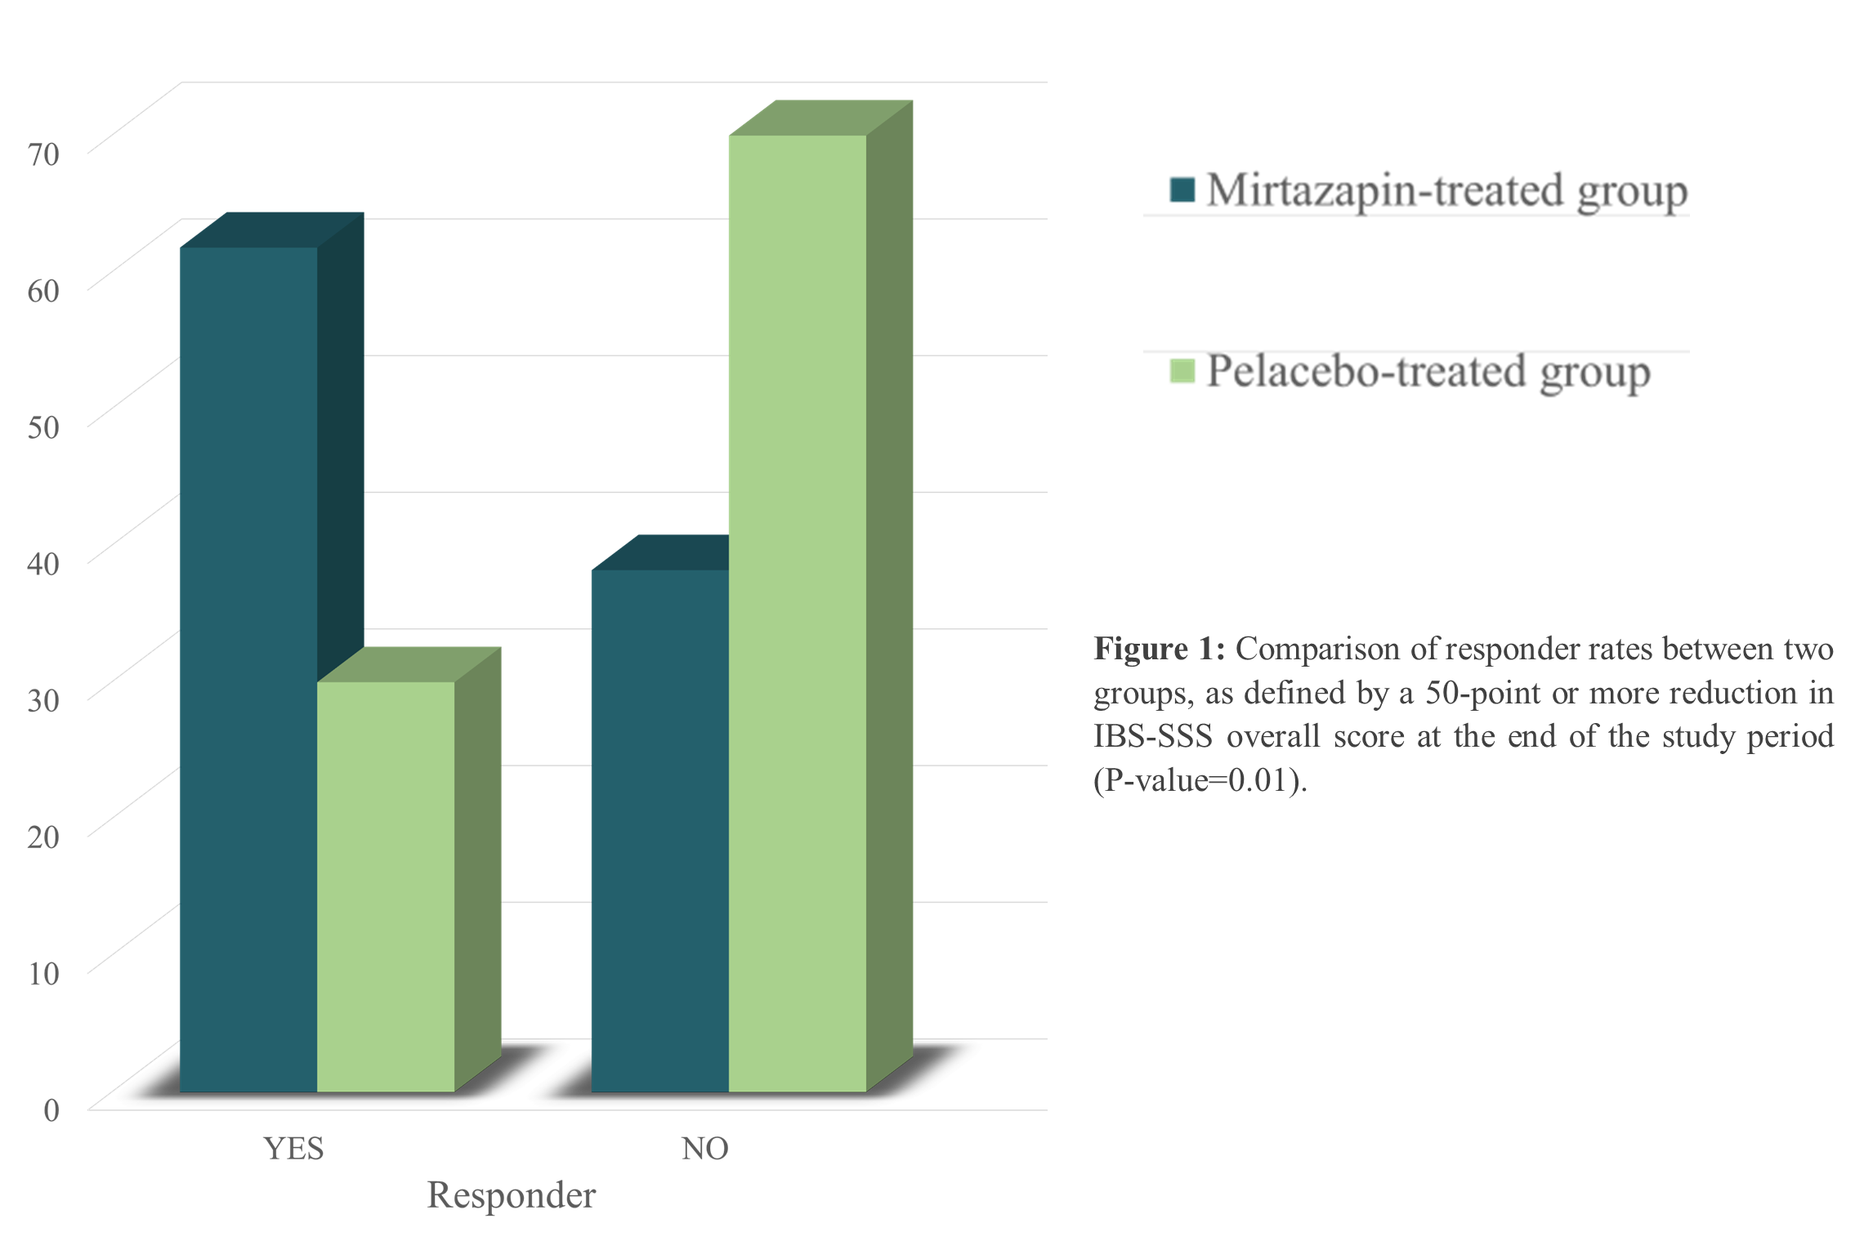
Figure1

Slide 9
Results
Results regarding the changes in the diary-based symptoms in the two groups have been reported in Table 2. All diary-derived symptoms except bloating showed significantly more improvement in the mirtazapine-treated subjects compared to the placebo-treated subjects. The average stool consistency score based on the BSFS score decreased from 5.5 to 4 by mirtazapine treatment. Mirtazapine also reduced the average daily bowel movement frequency from 2.30 to 1.83. Likewise, with regard to the mean average urgency or abdominal pain scores as well as the number of days with abdominal pain, urgency, and diarrhea, more favorable outcomes were observed in the mirtazapine-treated subjects compared to the placebo-treated subjects.

Slide 10
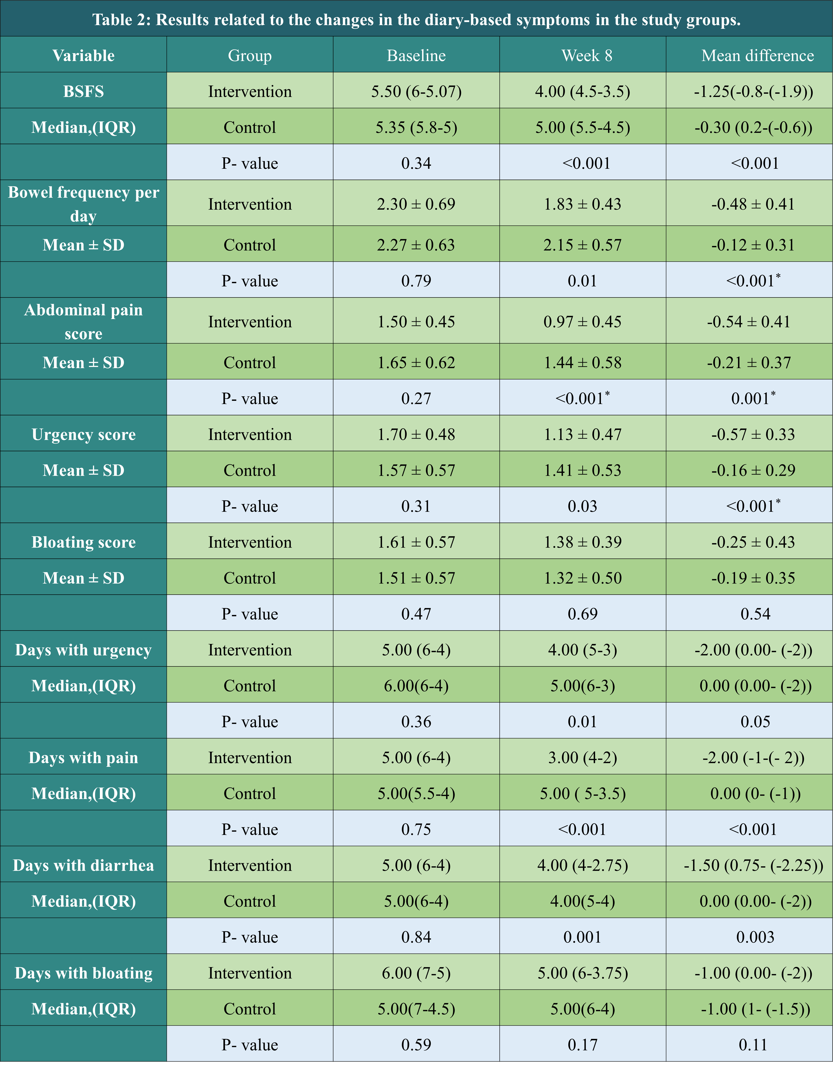
Table2
Table 2: Results related to the changes in the diary-based symptoms in the study groups.

Slide 11
Results
Concerning the frequency of drug-related adverse effects, adverse effects such as drowsiness, dry mouth, fatigue, and increased appetite were reported by a higher percentage of the mirtazapine-treated subjects compared to the placebo-treated subjects. Nevertheless, the adverse effects were mild to moderate in nature and remitted with ongoing therapy. 8 patients in the mirtazapine group and one patient in the placebo group gained weight (between 2-5kg, self-reported) which could be advantageous in the patients with anorexia. Mirtazapine was acceptably well-tolerated by a considerable percentage of the study patients and only 4 patients in the mirtazapine group discontinued their treatment due to intolerable adverse effects.

Slide 12
Conclusion
Our study provided primary evidence that patients suffering from IBS-D symptoms might benefit from mirtazapine treatment. Given that mirtazapine is generally better tolerated than TCAs, this evidence makes mirtazapine an attractive therapeutic option in the treatment of IBS. Benefits of mirtazapine treatment in patients with IBS-D are amplified by the fact that it is effective as both an etiological and symptomatic treatment in these patients. However, future studies with larger sample size and longer follow-up periods would be necessary to clarify the optimal dose as well as the safety and efficacy of mirtazapine in patients with other subtypes of IBS.

Slide 13
References
1- Koza J, Kwiatkowska R, Jurgoński A, Pujanek M, Ameryk M, Sikorski P, Meder A, Świątkowski M: The importance of serotonin in the gastrointestinal tract. Journal of Education, Health and Sport 2017, 7(12):104-110.
2- Crowell MD: Role of serotonin in the pathophysiology of the irritable bowel syndrome. British journal of pharmacology 2004, 141(8):1285-1293.
3- Stasi C, Bellini M, Bassotti G, Blandizzi C, Milani S: Serotonin receptors and their role in the pathophysiology and therapy of irritable bowel syndrome. Techniques in coloproctology 2014, 18(7):613-621.
4- Zheng Y, Yu T, Tang Y, Xiong W, Shen X, Jiang L, Lin L: Efficacy and safety of 5-hydroxytryptamine 3 receptor antagonists in irritable bowel syndrome: a systematic review and meta-analysis of randomized controlled trials. PLoS One 2017, 12(3):e0172846.
5- Alam A, Voronovich Z, Carley JA: A review of therapeutic uses of mirtazapine in psychiatric and medical conditions. The primary care companion for CNS disorders 2013, 15(5).
6- Heaton KW, O'Donnell L: An office guide to whole-gut transit time. Patients' recollection of their stool form. Journal of clinical gastroenterology 1994, 19(1):28-30.
7- Francis CY, Morris J, Whorwell PJ: The irritable bowel severity scoring system: a simple method of monitoring irritable bowel syndrome and its progress. Alimentary pharmacology & therapeutics 1997, 11(2):395-402.
8- Zigmond AS, Snaith RP: The hospital anxiety and depression scale. Acta psychiatrica scandinavica 1983, 67(6):361-370.
9- Patrick DL, Drossman DA, Frederick IO, Dicesare J, Puder KL: Quality of life in persons with irritable bowel syndrome (development and validation of a new measure). Digestive diseases and sciences 1998, 43(2):400-411.

Slide 14
Thanks for your attention
ご清聴ありがとうございました

